Slide 1


SPARKHUB
INFLUNCE PRO
INFLUNCERS AND
BRANDS COLLABRATIVE PLATFORM

Slide 2

Presented By :-
DineshKumar.C :510520104014
Deepan.D :510520104301 Dinesh.R:510520104012
Project Guide :- Mrs.B.Keerthi ,MTech AP/CSE
Head of the department: Mr.A.Sudhakar ,HOD/CSE

Slide 3
OBJECTIVE
The primary objective of SparkHub is to revolutionize influencer and brand collaboration in the digital marketing landscape. Through the development of a Python-based Flask web application, SparkHub aims to create a comprehensive platform that facilitates seamless partnerships between influencers and brands, driving impactful marketing campaigns and fostering mutual growth.

Slide 4
INTRODUCTION
In today's digital era, influencer marketing is vital for brands to authentically engage with target audiences. Social media influencers, with their vast followings, wield significant influence over consumer behavior and brand awareness. However, collaboration between influencers and brands faces challenges such as inefficiencies, transparency issues, and measuring campaign impact.

Slide 5
EXISTING SYSTEM
Influencer marketing faces challenges including inefficiencies, transparency issues, measurement difficulties, authenticity concerns, and regulatory compliance. Addressing these requires improved communication, transparency, measurement frameworks, and adherence to regulations.

Slide 6
EXISTING SYSTEM
Disadvantage:
1.Inefficiencies 2.Transparency Issues 3.Measurement Challenges 4.Authenticity Concerns 5.Regulatory Compliance 6.Market Saturation

Slide 7
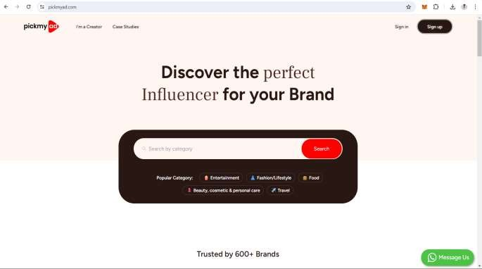
EXAMPLE EXISTING SYSTEM
PICKMYAD:
They only be the Midman platform for those who are all the customers And also not verifying all their campaigns

Slide 8
PROPOSED SYSTEM
SparkHub is an innovative influencer and brand collaboration platform aiming to transform how influencers and brands work together on marketing campaigns. Through advanced technology and unique features, SparkHub overcomes existing challenges and offers users significant benefits.

Slide 9
PROPOSED SYSTEM
Advantage:
1.Efficiency 2.Transparency 3.Improved Measurement 4.Enhanced Authenticity 5.Regulatory Compliance 6.Differentiation

Slide 10
SECURE HASHING ALGORITHM
SHA is the acronym for Secure Hash Algorithm, used for hashing data and certificate files. Every piece of data produces a unique hash that is thoroughly non- duplicable by any other piece of data.
SHA-256 is used in some of the most popular authentication and encryption protocols, including SSL, TLS, IPsec, SSH, and PGP. In Unix and Linux, SHA-256 is used for secure password hashing

Slide 11

HARDWARE
REQUIREMENTS
CPU: INTEL CORE I 5 OR HIGHER
RAM: 8 GB or more
Storage: 100 GB SSD or higher
Bandwidth: High- speed internet connection ( minimum 10 Mbps)

Slide 12
SOFTWARE
REQUIREMENTS
PYTHON: VERSION 3 .X
Visual studio code
My SQL Database
Flask Python Library

Slide 13
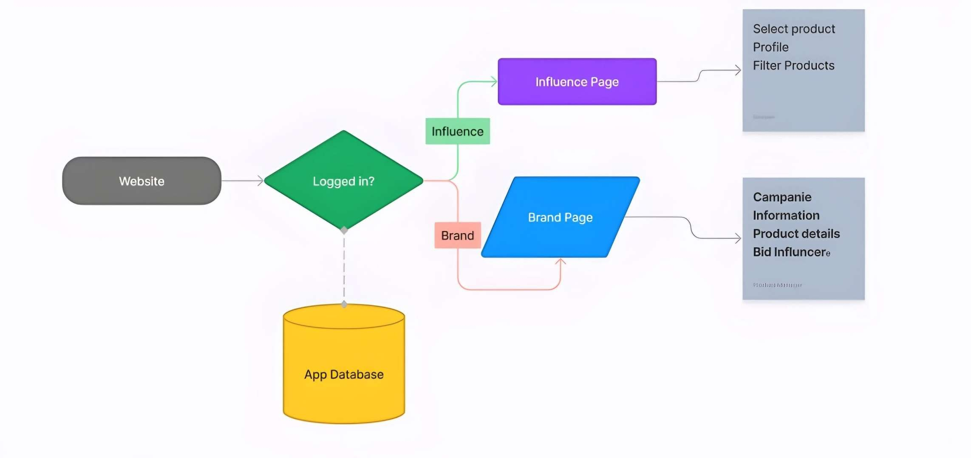
SYSTEM ARCHITTURE

Slide 14
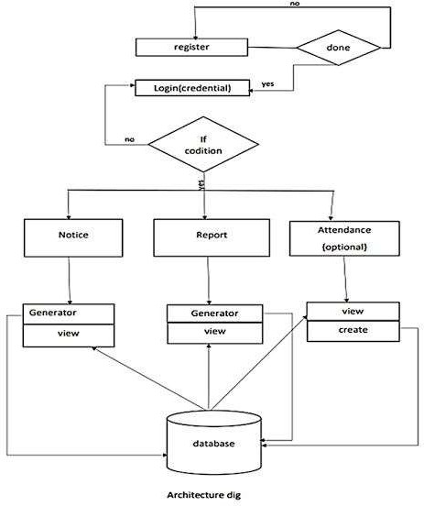
DATA FLOW DIAGRAM

Slide 15
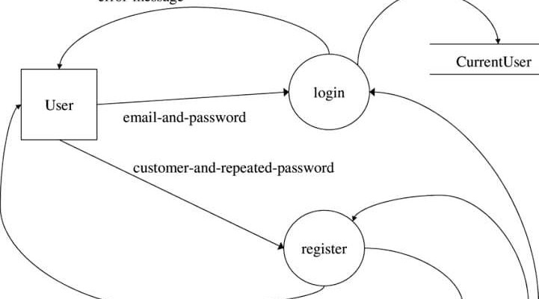
REGISTRATION PAGE

Slide 16
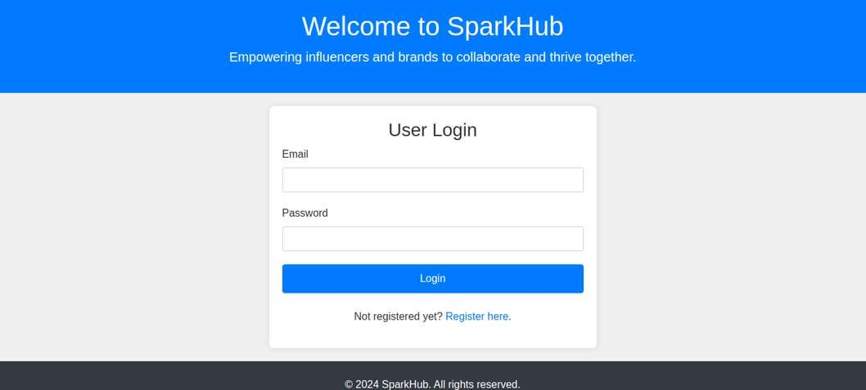
Login Page:
Add a “The login page enables secure access for registered users and offers options for password recovery and new account registration.”

Slide 17
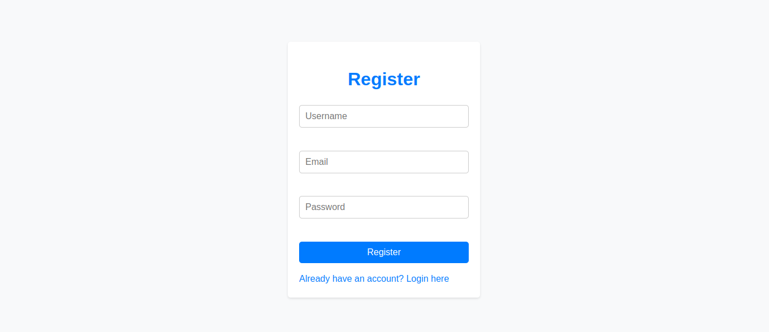
Registeration Page:
"The register page allows new users to create accounts, providing essential information to get started with our platform securely and efficiently.
Modules Description

Slide 18
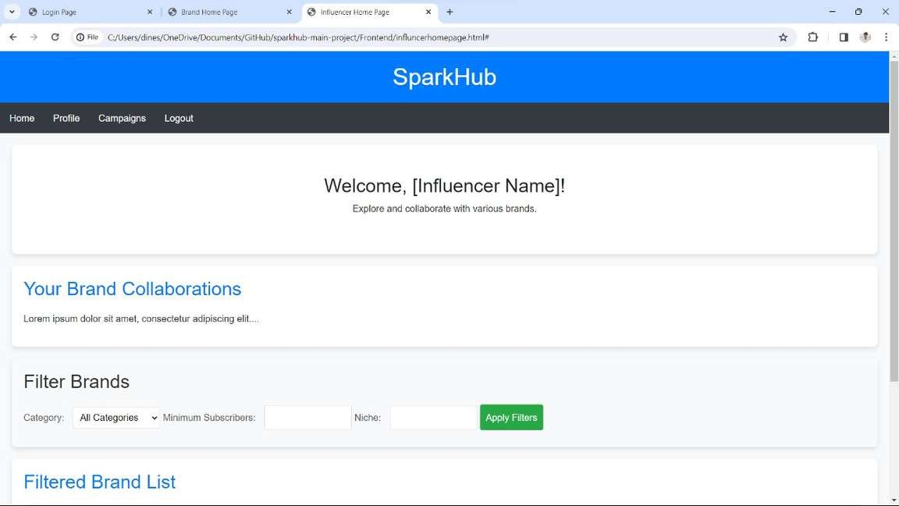
Influencer Home Page
"The influencer home page features essential elements such as profile management, enabling influencers to update their information, view analytics, and collaborate with brands. Additionally, it includes a logout option for secure session management."

Slide 19
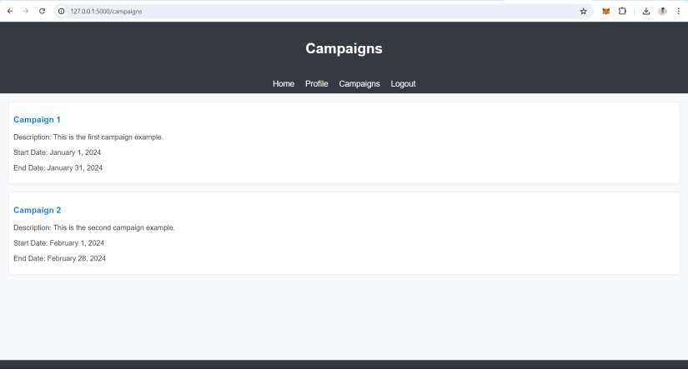
Modules Description Campaigns Page
The Campaigns Page module serves as a centralized platform where brands can create, manage, and monitor their marketing campaigns, and influencers can browse and apply to participate in these campaigns

Slide 20
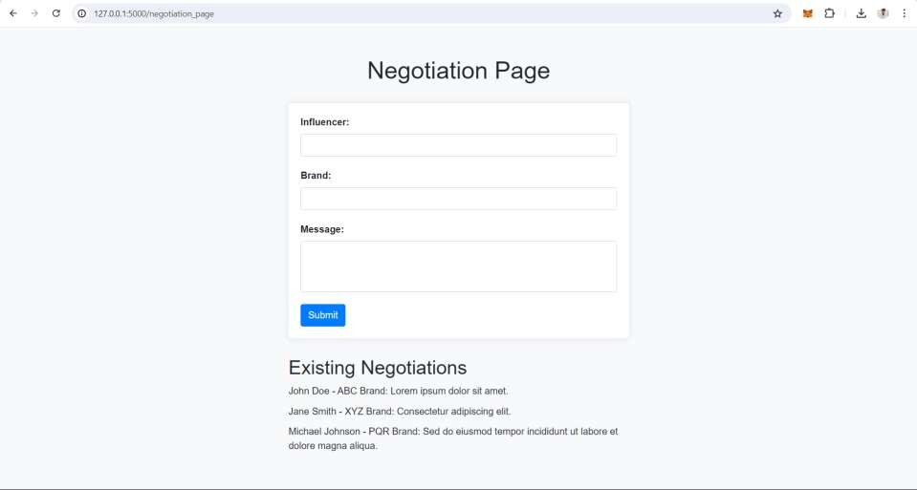
Modules Description Nogotiation Page
The Negotiation Page module facilitates communication and negotiation between influencers and brands. It provides a user interface where influencers can submit negotiation requests to collaborate with brands, and brands can view and respond to these requests.

Slide 21
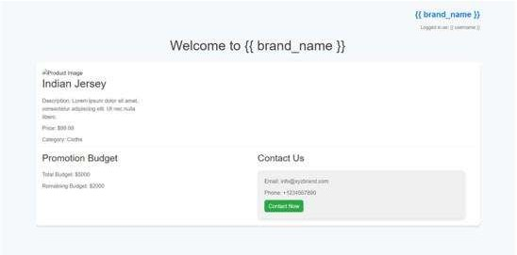
Brand Home Page
The brand landing page is where brands showcase products and campaign details to engage influencers effectively

Slide 22
Future Enhancement
1.Enhanced User Experienc 2.Advanced Analytic
3. AI-powered Recommendations 4.Mobile Application
5. Enhanced Security Measure. 6.Integration with E-commerce Platform

Slide 23
Conclusion
The Spark Hub project has successfully created a platform connecting influencers and brands for effective marketing campaigns. Leveraging Flask, MySQL, and Google OAuth, it offers scalability and security. Moving forward, continuous updates and community engagement will ensure its relevance and growth in the influencer marketing industry.

Slide 24
LITERATURE SURVEY
Therefore, for this project, the references would include: •
Flask Documentation: Official documentation for https://flask.palletsprojects.com/
SQLAlchemy Documentation: Official documentation
Flask web framework -
for SQLAlchemy ORM -
https://www.sqlalchemy.org/
MySQL Documentation: Official documentation for MySQL database management system -
https://dev.mysql.com/doc/
Google OAuth Documentation: Documentation https://developers.google.com/identity/protocols/oauth2
for Google OAuth authentication -
Bootstrap Documentation: Documentation for Bootstrap framework for frontend design - https://getbootstrap.com/docs/5.1/gettingstarted/introduction/

Slide 25
REFERENCE
PickMyAd" is a web application designed to manage advertisement campaigns, offering features like campaign creation, budget management, audience targeting, and performance tracking.
The platform streamlines the advertising process by allowing users to create, manage, and track campaigns across different platforms while providing analytics to optimize campaign effectiveness.

Slide 26
INFLUNCE PRO
THANK YOU
ANY QUESTIONS?

